Slide 1
Difference Between RISKC & CISC
U19CS012
BHAGYA RANA

Slide 2
Wait…Where did RISC/CISC Come From?
Q1.) What is Processor?? Another Term for CPU
Q2.) What does it Do?? Fetching, Decoding, Executing, WriteBack
Q3.) 2 Architecture Types of Micro-Processor:
Reduced
RISC
Complex
CISC

Slide 3
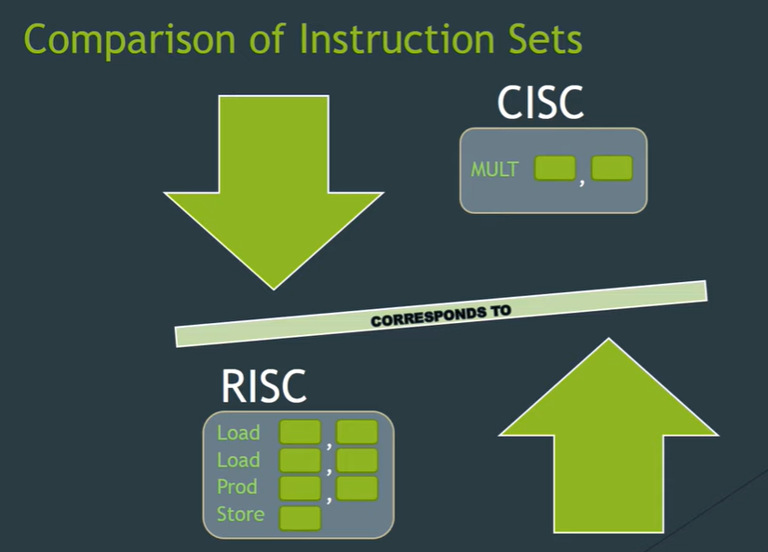

Slide 4
 | RISC [Reduced Instruction Set Computer] | CISC [Complex … ]
Name me Kya Rakha Hai? | REDUCED = Few Instruction | COMPLEX = Large Number of Instruction
Instruction Format | uses a small set of instructions of uniform length [Fixed Length, Easily Decoded ] | hundreds of instructions of variable sizes [Variable Length Instruction Format]
Clock Time | These are simple instructions which are generally executed in one clock cycle [1 line of Assembly = 1 Clock cycle] | Instruction may take more than single clock cycle to get executed. [1 line of Assembly = Multiple Clock cy.]
Addressing Modes | Few Addressing Modes [4-5] | Large Variety Of Addressing Modes[12]
Array/If-else Support?? | Less Data types [Doubtful] | More Data types
FOCUS on? | Software (Code is Long but Simple) | Hardware (Why? -> Code is Short & Complex)
Kitne Register Chahiye? | More || Easy to Pipeline | Less (Why?) [ operation get performed in memory itself ]
USE Kaha Hai? | SPARC, POWER PC, SnapDragon ->Mobile Phones (Why? [ Power Efficient ] ) | Intel Processor in PPT Machine, AMD

Slide 5
CISC
The primary goal of CISC architecture is to complete a task in as few lines of assembly as possible.
This is achieved by building processor hardware that is capable of understanding and executing a series of operations.

Slide 6
Then Who is the Winner? RISC || CISC ?

Slide 7
ANSWER : Both are Best at there Own Field
RISC -> Perform Easy TASKs FASTER & Takes Less Energy
CISC -> Takes Time, But can Perform Complex Tasks! & Takes More Energy…

Slide 8
Rise of EPIC !! (Not Ice-Cream!)
Explicitly Parallel Instruction Computing
best features of RISC and CISC processors are combined in the architecture
implements parallel processing of instructions

